Slide 1
Vision-based human-computer interaction
Julia Kuosmanen
(publishes under name Gizatdinova)
Tampere Unit for Computer Human Interaction
School of Information Sciences
University of Tampere

Slide 2
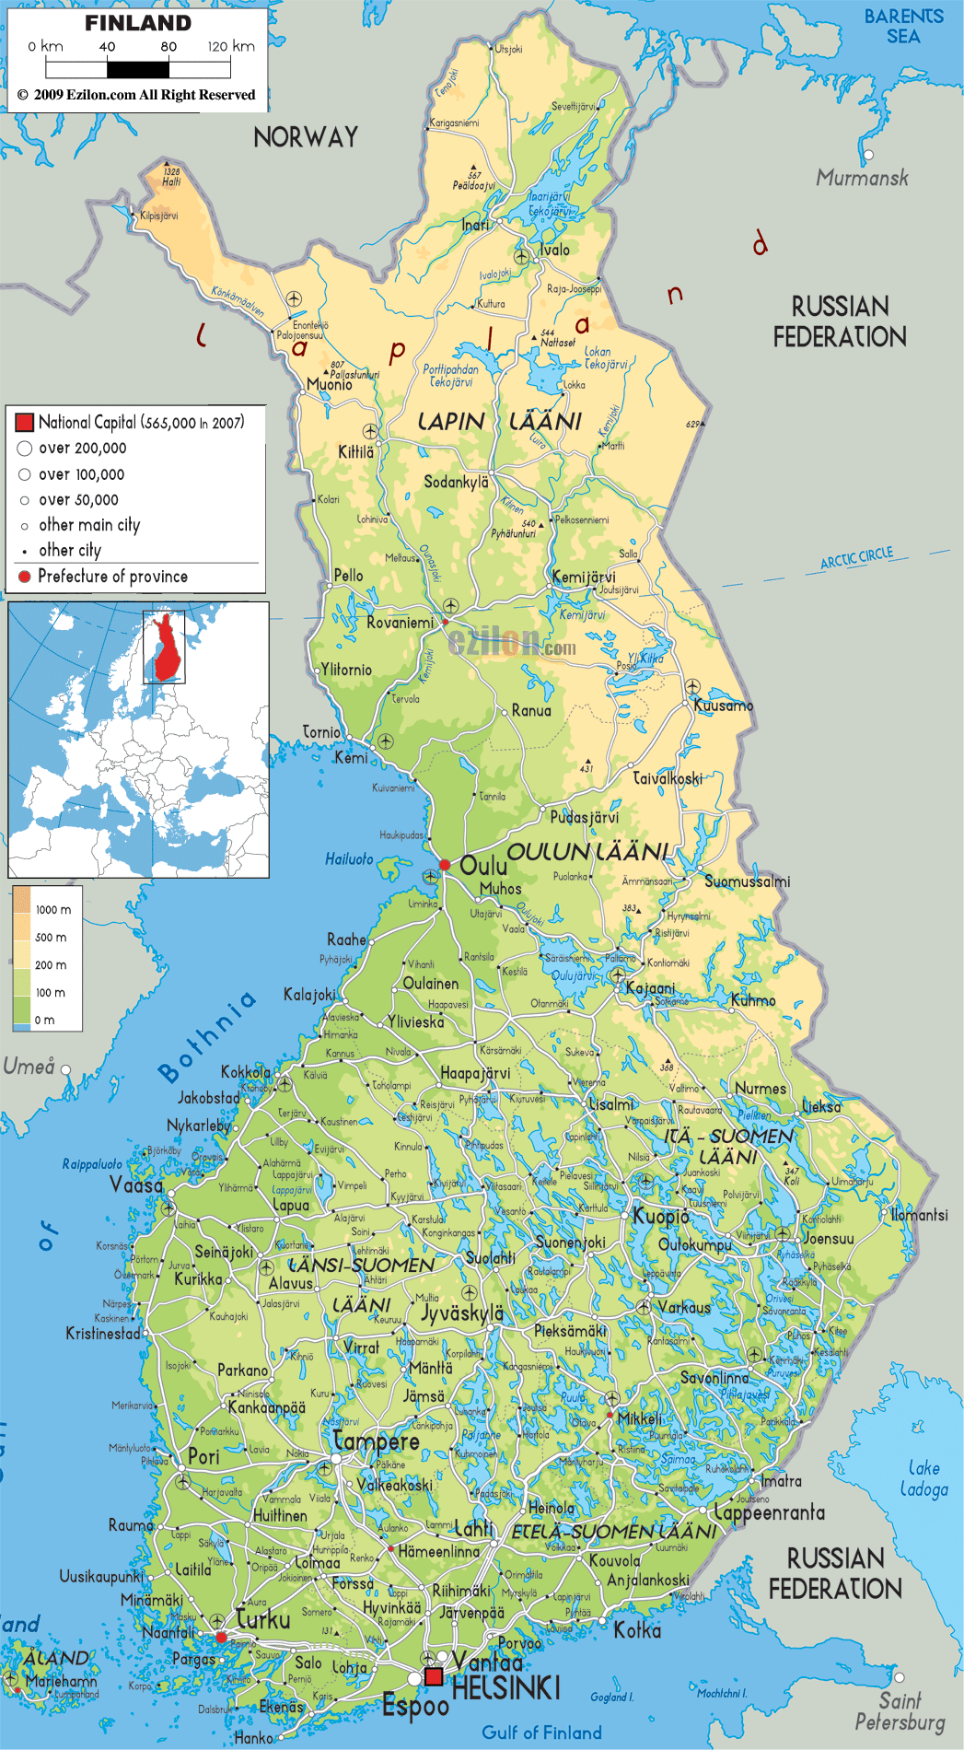
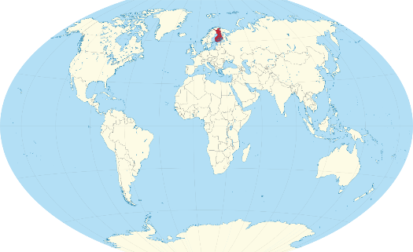
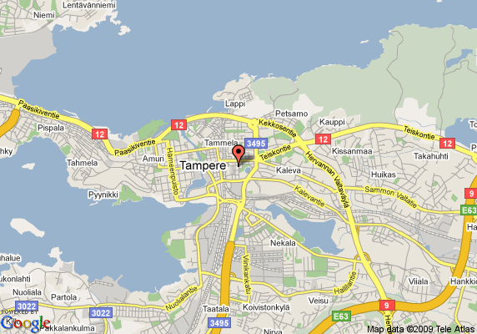


Slide 3
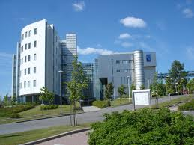


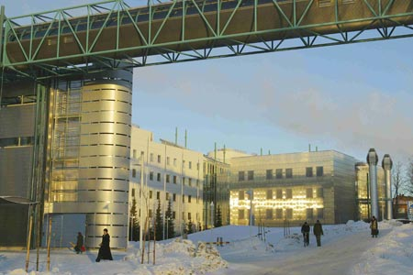
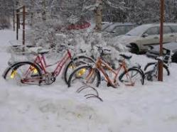

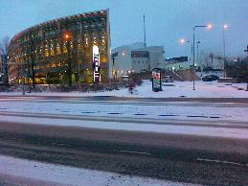
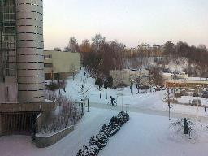


Slide 5


Slide 6



Slide 7



Content
  School of Information Sciences
  Post doc project: UCSB visit 2015
Tampere Unit for Computer Human Interaction
Tampere Research Center for Information and Systems
Tampere Research Center for Information and Media

Slide 8
Tampere Unit for Computer Human Interaction
http://www.uta.fi/sis/tauchi
  TAUCHI’s mission is to carry out multidisciplinary research into human-technology interaction and its development, harmonizing the potential of technology with human abilities, needs and limitations
  TAUCHI consists of 4 research groups:
    Emotions, Sociality and Computing
    Visual Interaction
    Multimodal Interaction
    Speech-Based and Pervasive Interaction

Slide 9
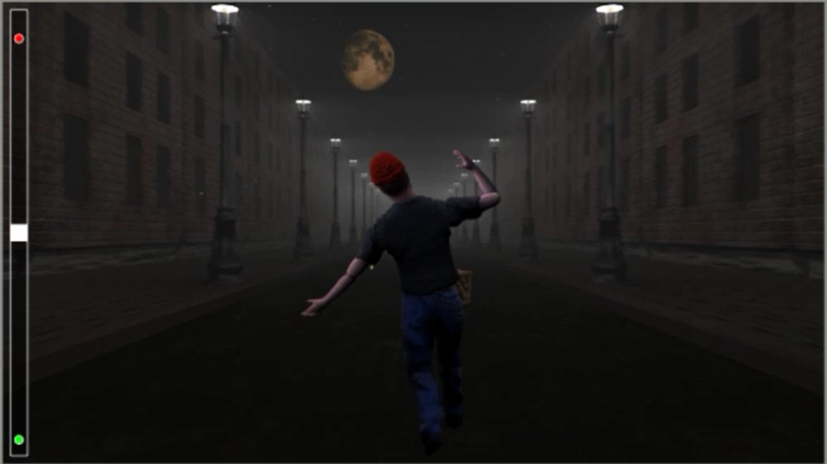
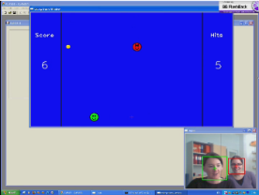
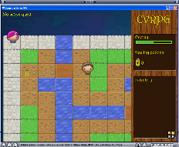
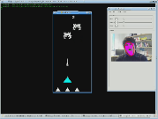
Tampere Unit for Computer Human Interaction
http://www.uta.fi/sis/tauchi
Computer vision research
  Mäkinen E., PhD, Face detection and gender classifcation, 2007
  Gizatdinova Y., PhD, Face and facial feature localization, 2009
  Finnish-Russian consortium project funded by the Academy of Finland and Russian Foundation for Humanities, 2009-2012
    Face-responsive vision-based user interfaces
      Hands-free text entry
      Video gaming (videos)

Slide 10
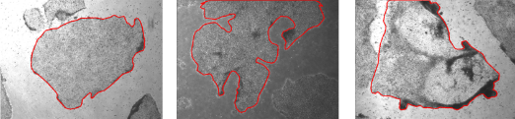
Tampere Unit for Computer Human Interaction
http://www.uta.fi/sis/cis
Human Spare Parts project, European Regional Development Fund (2013-2014)
  Regea - Institute for Regenerative Medicine, University of Tampere and Tampere University Hospital
  Induced pluripotent stem cells (iPSC)
  iPSC colony segmentation and classification
Good, healthy iPSC colonies
Semigood iPSC colonies with small defects
Bad, abnormal iPSC colonies

Slide 11
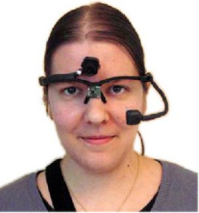
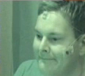

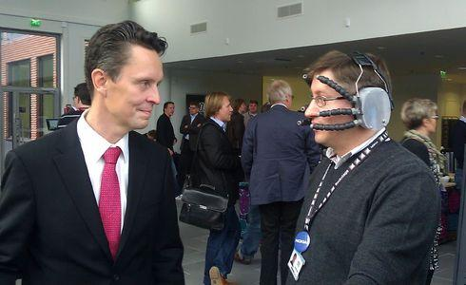
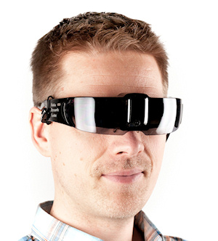


Tampere Unit for Computer Human Interaction
http://www.uta.fi/sis/tauchi
Mobile eye tracking and smart headwear
Scene camera
Capasitive sensors
IR camera
EMG-based face interface
Face Interface
University of Tampere (UTA) & Technical University of Tampere (TUT)
Tobii mobile eye tracker
Facehugger
UTA & TUT & Nokia
(video)
Near-eye-display
TUT & Nokia

Slide 12
Tampere Unit for Computer Human Interaction
http://www.uta.fi/sis/tauchi
Attention Training and Control (ATRACT) project
  TAUCHI & Psychology Clinic PSYKE, School of Social Sciences and Humanities, University of Tampere
  Children with attention deficit/hyperactivity disorder (ADHD)
    Inattention, hyperactivity and impulsivity deficits
  Non-verbal behaviour analysis, i.e. gaze, head orientation, facial expressions and body movements/gestures will be used for understanding and rehabilitation of ADHD
  Visual pathways occupy up to 85% of brain structure
  Visual attention training is expected to help in improving attention skills in general
  Attention training is expected to improve the skills of eye-hand-body coordination and muscle/impulsivity control

Slide 13
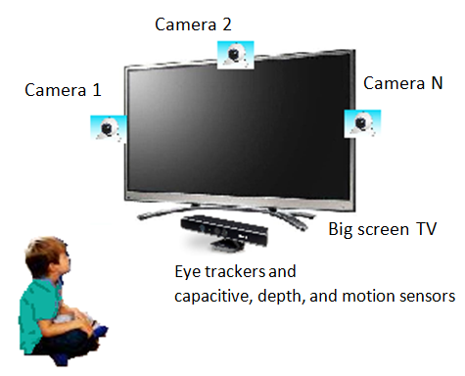
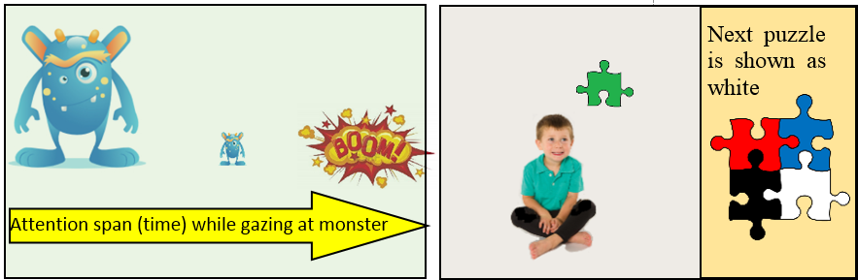
Tampere Unit for Computer Human Interaction
http://www.uta.fi/sis/tauchi
Attention Training and Control (ATRACT)
  Eye/gaze-based games
  Computer vision-based games
  Capacitive, depth and motion sensor technology

Slide 14
Post doc project / UCSB visit 2015
Vision-based user interfaces for hands-free text entry

Slide 15
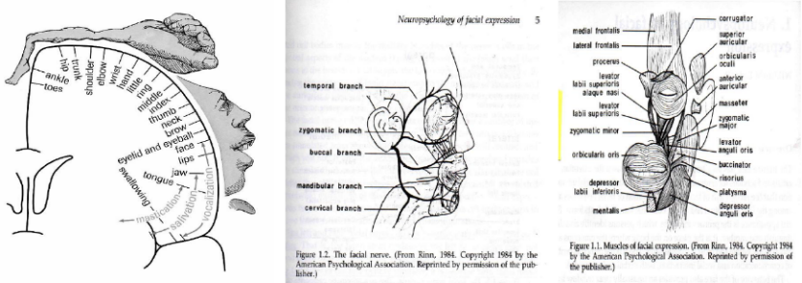
Vision-based user interfaces for hands-free text entry
Post doc project / UCSB visit 2015
  Face is one of the most important means of communication with people
  Many facial expressions can be performed on a voluntary basis with a fine-grained resolution
  Aim is to investigate vision-based user interfaces that utilize voluntarily produced and controlled head movements and facial expressions for the task of text entry
Cortical motor strip (left), facial nerve system (center) and facial muscles (right)

Slide 16
Vision-based user interfaces for hands-free text entry
Post doc project / UCSB visit 2015
Study 1: Gaze pointing vs. head pointing for text entry*
  Aim was to investigate how the pointing techniques affect performance and subjective experiences of novice users in text entry tasks
  Key pointing by gaze or head; key selection by hand
  Text corrections: not allowed (typing as fast and accurate as possible)
  Keyboard size: small (75x75), medium (95x95) and large (115x115) for screen resolution 1280x1024
  15 novice participants
  Within subject 2 (pointing technique) x 3 (keyboard size) repeated measures factorial design
  The total number of phrases (~150 characters) typed per participant was 15 (participants) x 2 (techniques) x 3 (keyboard sizes) x 5 (trials) = 450
  Likert scales for subjective evaluation
  * Gizatdinova Y., Špakov O., Surakka V. (2012). Comparison of video-based pointing and selection techniques for hands-free text entry. Int. Working Conf. Advanced Visual Interfaces AVI’12, ACM, 132-139

Slide 17
Vision-based user interfaces for hands-free text entry
Post doc project / UCSB visit 2015
Study 1: Gaze pointing vs. head pointing for text entry*
  Gaze pointing resulted in significantly faster typing speed than head pointing
  Head-based pointing was more accurate, stable and lesser dependent on the size of the virtual keyboard as compared to gaze pointing
Mean text entry speed in words per minute (WPM)
Mean error rate
  * Gizatdinova Y., Špakov O., Surakka V. (2012). Comparison of video-based pointing and selection techniques for hands-free text entry. Int. Working Conf. Advanced Visual Interfaces AVI’12, ACM, 132-139

Slide 18
Vision-based user interfaces for hands-free text entry
Post doc project / UCSB visit 2015
Study 1: Gaze pointing vs. head pointing for text entry*
  * Gizatdinova Y., Špakov O., Surakka V. (2012). Comparison of video-based pointing and selection techniques for hands-free text entry. Int. Working Conf. Advanced Visual Interfaces AVI’12, ACM, 132-139

Slide 19
Vision-based user interfaces for hands-free text entry
Post doc project / UCSB visit 2015
Study 2: Mouth open selection vs. brows up selection for text entry*
  Aim was to investigate how the selection techniques affect performance and subjective experiences of novice users in text entry tasks
  Key pointing by head; key selection by mouth open or brows up gestures
  Text corrections: not allowed (typing as fast and accurate as possible)
  Keyboard size: medium (95x95)
  13 novice participants
  Within-subject single factor repeated measures design
  The total number of phrases (~150 characters) typed per participant was 13 (participants) x 2 (selection techniques) x 5 (trials) = 130
  Likert scales for subjective evaluation
  * Gizatdinova Y., Špakov O., Surakka V. (2012). Comparison of video-based pointing and selection techniques for hands-free text entry. Int. Working Conf. Advanced Visual Interfaces AVI’12, ACM, 132-139

Slide 20
Vision-based user interfaces for hands-free text entry
Post doc project / UCSB visit 2015
Study 2: Mouth open selection vs. brows up selection for text entry*
  No differences in speed
  Mouth open was more accurate than brows up selection technique
Mean text entry speed in words per minute (WPM)
Mean relative error rate
  * Gizatdinova Y., Špakov O., Surakka V. (2012). Comparison of video-based pointing and selection techniques for hands-free text entry. Int. Working Conf. Advanced Visual Interfaces AVI’12, ACM, 132-139

Slide 21
Vision-based user interfaces for hands-free text entry
Post doc project / UCSB visit 2015
Study 2: Mouth open selection vs. brows up selection for text entry*
  * Gizatdinova Y., Špakov O., Surakka V. (2012). Comparison of video-based pointing and selection techniques for hands-free text entry. Int. Working Conf. Advanced Visual Interfaces AVI’12, ACM, 132-139

Slide 22
Vision-based user interfaces for hands-free text entry
Post doc project / UCSB visit 2015
Study 3: Eye tracking vs. computer vision for text entry
  Aim was to investigate gaze-based and face-based interfaces for text typing
  Gaze-based interface: pointing by gaze, selection by adjustable dwell time
  Face-based interface: pointing by head, selection by mouth open gesture
  Text corrections: allowed (correctness of the text was a priority)
  3 sessions
    main experiment (24 novice participants)
    2 follow up experiments (13 participants from the main experiment)
  Keyboard size: 50x50 (40x40, 32x32, 25x25 used in a pilot)
  24 novice participants
  Within-subject single factor repeated measures design
  ~15 minutes of typing with each interface
  Likert scales for subjective evaluation

Slide 23
Vision-based user interfaces for hands-free text entry
Post doc project / UCSB visit 2015
Study 3: Eye tracking vs. computer vision for text entry

Slide 24
Vision-based user interfaces for hands-free text entry
Post doc project / UCSB visit 2015
Study 3: Eye tracking vs. computer vision for text entry

Slide 25

Vision-based user interfaces for hands-free text entry
Post doc project / UCSB visit 2015
Study 4: Investigating optimized keyboard layouts for computer vision input
  Aim is to develop and evaluate a keyboard layout that is optimized for computer vision input
  Additional visual gestures: head rotations and tilts, approaching to / withdrawal from the camera
  Facereader 6.0 by Noldus Information Technology
Left: A schematic representation of a keyboard layout with different characters (C) and submenus assigned to the keys. Right: Popup menus with different options (O) and rest zones (R)

Slide 26
Vision-based user interfaces for hands-free text entry
Post doc project / UCSB visit 2015
Plans for 2015:
No | Task | Deadline
1 | Analyze results from Study 3 | February 15
2 | Write a paper | March 15, Computer Vision and Image Understanding, Special Issue on Assistive Computer Vision and Robotics
3 | Develop the first prototype of the optimized keyboard, piloting, literature review | June 30
 | Summer holiday | July
4 | Implement software for experiment | August 31
5 | User study | Autumn
6 | Analyze the results and write a paper | Winter

Slide 27


Thank you for your attention
julia.kuosmanen@sis.uta.fi

