Slide 1
Navigating The Peer Review Process.
John O’Donovan
Four Eyes Lab Lunch Seminar, Jan 26th 2012

Slide 2


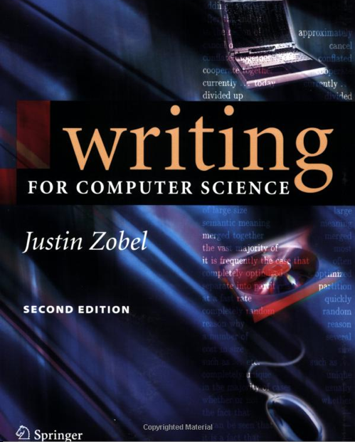
Overview
Part 1: The peer review process
Part 2: Examples. From a "diverse cross-section” of our lab team! >>>>>>>>>>>>>
Part 3: Writing a CS paper for peer review. Partly inspired by “Writing for Computer Science” by Justin Zobel, (Springer 2004), partly pulled out of a slightly worn hat.
Notes:
$17.99 on Amazon

Slide 3
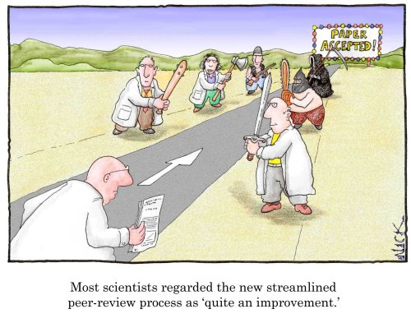
Part 1: The Peer Review Process

Slide 4
Ethics Issues
Adapted from a long (52 pages of dense text) slide set by Sara Rockwell, Associate Dean for Scientific Affairs at Yale University.

Slide 5
Peer Review
The peer review of scientific manuscripts is a cornerstone of modern science.
Peer reviewed journals rely on expert and objective review by knowledgeable researchers to ensure the quality of the papers they publish.
The collective activities of the investigators who review manuscripts in a scientific discipline are critical to maintaining the standards of the journals and the field.

Slide 6
Acceptance Rates
  Acceptance rates vary by venue and to a lesser extent, by year.
  Most journals accept 30% or less (NEJM, BMJ accept ~ 10%, Nature: ~7%)
  Computer science conferences: ~5-100%

Slide 7
The review of manuscripts raises many ethical issues and problems
Reviewers should be aware of these
  When deciding whether to review a paper
  Throughout the review process
  After they submit their reviews
The ethical issues can be vexing and complex.
There may be no clear right or wrong pathway to follow .

Slide 8
To be a good reviewer, one must understand the peer review process and the role of the reviewer
Journal staff – oversees the receipt of manuscripts, manages communications with authors and reviewers and processes accepted manuscripts for publication
Scientific editors - make the final decision as to whether a specific manuscript will be accepted for publication, returned for revisions, or rejected
Members of the editorial board – read and review papers, select reviewers and monitor quality of reviews, and recommend actions to editor
Reviewers – provide reviews of manuscripts, make recommendations concerning publication

Slide 9
What do the editors look for in reviewers?
Expertise in one or more areas of paper
Objectivity
No conflicts of interest
Good judgment
Able to think clearly and logically
Able to write a good critique
  Accurate
  Readable
  Helpful to editors and authors
Reliable in returning reviews
Able to do the review in the allotted time frame

Slide 10
Overview of review process
(considerable variation between journals)
Potential reviewer contacted by journal
Given authors, title, abstract, and time frame for review
Reviewer agrees to review paper (or declines)
Reviewer receives paper
Reviewer performs review
Reviewer submits review to editors
Editors examine reviews, obtain additional reviews if needed, and make decision
Decision goes to author, with comments from reviewers
Reviewer thanked; may be informed of decision; may receive copy of comments sent to author

Slide 11

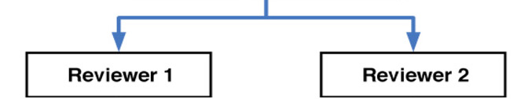
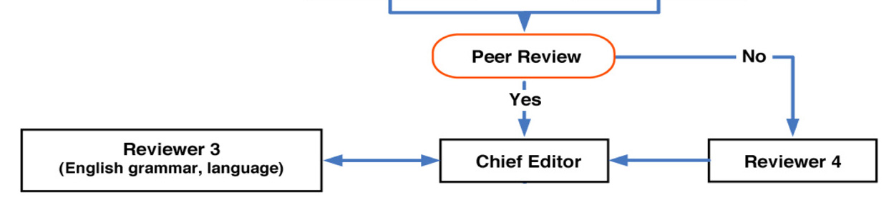
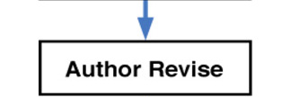

Slide 12
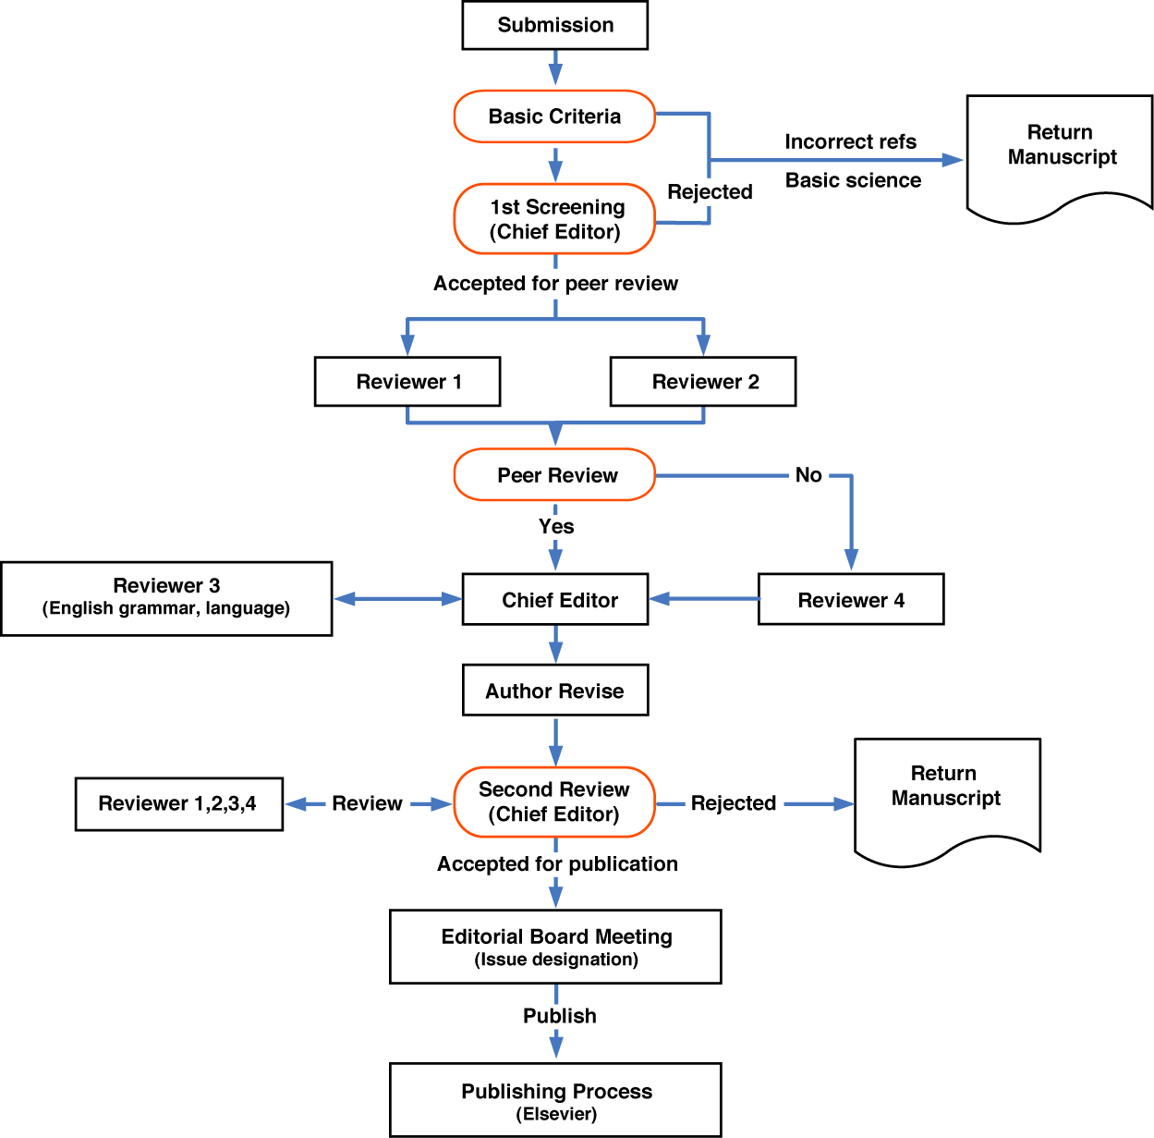

Slide 13
Content of reviews
Review form
Comments to editor
Comments to authors
  General comments
  Specific recommendations
Journal may ask specific questions to ensure that specific points are addressed

Slide 14
Reviews are generally blinded
Reviewer’s identity is known to editors and journal staff
Reviewer’s identity usually will not be released to authors
Reviewer’s identity usually will not be released to third parties
Intended to shield reviewers and allow them to provide critical and honest reviews
No system is perfect - authors sometimes discover the identities of reviewers

Slide 15
From an editor’s point of view the ideal reviewer
Is a researcher who is working in the same discipline as the subject of the paper yet is not in direct competition with the authors
Will understand the hypotheses underlying the work
Will be familiar with the model systems and methods used in the project
Will be able to judge the quality of the data and analyses and assess the validity of the conclusions
Will be able to assess the significance of the work

Slide 16
Questions to consider when deciding whether to review a paper
Do you have appropriate expertise?
  Ideal reviewers seldom exist
  Editors often send papers to multiple reviewers, with different areas of expertise and different perspectives
  Young reviewers tend to underestimate their expertise
  If in doubt, contact the editor and discuss your concerns

Slide 17
Is the work too close to your own?
Example: paper contains experiments that overlap with those you are performing, planning, or preparing for publication
Decline to review paper
  Conflict of interest precludes review
  There would be a danger of the appearance of misconduct, even if you acted ethically throughout the review process
Make every effort to avoid receiving the full paper – if you receive it, return it immediately and discuss this problem with editor

Slide 18
Do you have any real or apparent conflicts of interest
Institutional affiliations
  Through current institution
  Past institution (recent enough to have close associations)
  Future institution (e.g. negotiating for a position)
  Consultant to author’s institution
Collaborators and colleagues
  How close?
  When?
Other relationships with the authors
  Family
  Personal friends
  People you detest
  People you would be reluctant or afraid to give a harsh review to

Slide 19
Do you have the time to review the article within the time requested by the editor?
Reviewing manuscripts take times. Most reviewers estimate that they spend 1-2 hours on a typical manuscript review. Some reviews prove difficult and require much longer.
The time frame to finish the review is often short.
Reviewing is an unfunded, largely unrewarded task – and it comes on top of the reviewer’s other responsibilities.
Researchers perform reviews because they are good citizens of the scientific community.
Even the most conscientious scientist will have times when he or she is simply unable to take on an additional task.
In such cases the invited reviewer should decline to review.

Slide 20
Issues to consider once you have received the full paper
Does seeing the full paper change your ability to review it?
  Content different from that described in abstract
  Hidden conflicts of interest
Again the basic rule of thumb is to contact the editor as soon as possible to discuss and resolve such problems.

Slide 21
How do you handle the paper?
Manuscripts under review are confidential documents.
They contain unpublished data and ideas, which must be kept confidential.
You cannot share the paper or its contents with your colleagues.
Manuscripts should be kept in a secure place, where they will not be readily accessible to the curious or unscrupulous.

Slide 22
Remember:
You cannot use the information in the paper in your own research or cite it in your own publications.
This can raise serious ethical issues if the work provides insights or data that could benefit your own thinking and studies.

Slide 23
Confidentiality is critical
Not only the paper, but also the outcome and content of the review are confidential.
Lapses in the confidentiality undermine the review process, betray the trust of the authors and the editors, and can create serious problems for everyone involved in the reviews.

Slide 24
Can you pass the paper on to someone else to review?
Only with the permission of the editor
Permission sometimes granted in cover letter; if not, the editor should be contacted in advance
The reviewer initially contacted should always let the editor know that the manuscript has been given to another reviewer
  Important for journal records
  Journal staff may need to configure web portal for the new reviewer
  Allows actual reviewer to receive credit for his/her efforts

Slide 25
You are the agent of the journal, not the friend of the author
New reviewers often empathize with the authors of the manuscripts they review.
It is sometimes difficult to adopt a more institutional perspective and to realize that the reviewer’s primary role is to advise the journal, not to help the author publish the paper.
A reviewer may feel bad about rejecting a paper and empathize with the authors, but she/he must be able to make a recommendation for rejection when it is the appropriate one.

Slide 26
A seriously flawed paper must be challenged
The reviewer must remember that it is unethical to allow a badly flawed paper to pass unchallenged into the peer reviewed literature, where it will be a trap to the unsophisticated reader who will read the manuscript (or perhaps only the abstract) superficially and will simply accept the flawed conclusions at face value.

Slide 27
Articles in peer reviewed journals are trusted by readers who would be skeptical of claims made in non peer reviewed sources
The peer review process is viewed by scientists and the public as providing a scientific stamp of approval to the paper and its contents.
The reviewer therefore has an ethical obligation to support work of high quality while appropriately challenging flawed papers.

Slide 28
Some ethical issues to consider as you read and review the paper
Can you contact the author about the work or the paper?
  No – this destroys the blinding of the review process
  If you need information from the author, contact the journal staff, and they will contact the author

Slide 29
Reviewers must be wary of unconscious biases
Positive results are viewed as more exciting than negative results and are therefore more likely to be published
  Bias toward a benefit from a experimental drug in a clinical trial
  Bias toward finding a toxic effect associated with an environmental pollutant
Papers that challenge existing dogma or that present surprising findings may be dismissed too readily during the review process
  Bias against surprising new ideas
  Bias against very novel techniques
Notes:
Speculative papers

Slide 30
Some editorial comments are appropriate
There are cases where reviewer should make editorial comments.
He/she should identify sentences or paragraphs where the wording is sufficiently erroneous or ambiguous that the science is unclear.
She/he should also point out editorial errors that result in scientific misstatements.
He/she should point out errors in referencing.
A note that a manuscript requires major editorial assistance or a warning that a manuscript is so carelessly prepared that the science cannot be rigorously reviewed is always in order.
Reviewers should not waste inordinate amounts of time correcting minor problems with spelling, grammar, or punctuation.

Slide 31
Focus on the science
The review should focus on the science: the appropriateness of the techniques, the strengths and weaknesses of the experimental design, the quality of the data and analyses, and the appropriateness and impact of the conclusions drawn by the authors.
The comments made in the review should present clearly the reviewer’s analysis of the quality, novelty, and importance of the science and the effectiveness and appropriateness of its presentation in the manuscript.

Slide 32
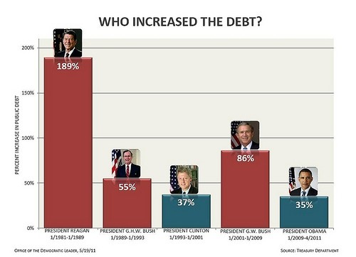
Focus on the science
Reagan: plus 14.9 percentage points
GHW Bush: plus 7.1 percentage points
Clinton: down 13.4 percentage points
GW Bush: plus 5.6 percentage points
Obama: plus 24.6 percentage points
Source: Washington post. 09/29/11

Slide 33
Duplicative publication or plagiarism
The reviewer may recognize much or all of the paper, because some or all of the paper has been published previously by the same authors.
The reviewer may find text or ideas which have been copied without permission or appropriate attribution from the works of others.
Notes:
Background research review

Slide 34
Writing the review
Reviews can be difficult to write.
They must be clear, concise, and accurate.
Although their primary purpose is to advise the editor, comments to the author frequently are of value in guiding revision of the paper for the same or a different journal and in suggesting ways to improve the project by the inclusion of additional data or experiments.
Comments to the author may be very brief, especially in the case of an excellent, well prepared paper.
They may be extensive if the reviewer feels the paper has valuable elements but requires extensive revisions to present the findings effectively.

Slide 35
Rude reviews
Some reviewers submit critiques that are so rude, snide, sarcastic, argumentative, or even obscene that they must be censored before being sent to the authors.
Some are not transmitted, depriving the author of any beneficial insights the reviewer might have had.
Rudeness, personal criticism and locker room humor are never appropriate.
Even the most serious scientific criticisms can be worded and presented in such a way as to be constructive and collegial.
Reviewers should write critiques using a style and tone that they would want to see in the reviews that they or their trainees receive.
Reviewers should remember that they are setting the standards of behavior and collegiality for their field, as well as the standards of science.

Slide 36
Conclusions
The review of manuscripts for peer reviewed journals raises many ethical issues and problems.
Reviewers should be aware of these when deciding whether to review a paper, throughout the review process, and even after they submit their reviews.
Forethought and planning will enable the reviewer to avoid many potential ethical problems.
Others ethical problems may appear without warning.
When in doubt about ethical issues, the reviewer should discuss his/her concerns with the editor or the journal staff.
The reviewer should always work to provide reviews that meet high standards of ethics as well as high standards of science.

Slide 37
Part 2: “Our” Peer Review Experiences
Some Examples:
1: Good Review / Good Paper
2: Good Review / Bad Paper
3: Conflicted/Polarized Reviews (really frustrating!)
4: A bad (quality) review
5: Totally Nonsensical Paper, Accepted in Reviews = Bad Journal
6: Bad Review / Plagiarized Paper
7: Example of a successful rebuttal

Slide 38
Part 3: Writing a CS Paper for Peer Review
“No tale is so good that it can’t be spoiled in the telling”
-Proverb
Notes:
24.46@amazon

Slide 39
Style
Economy
Tone
Motivation
Balance
The upper hand
Reference & Citation
Grammar & Beauty

Slide 40
Style Specifics
Titles & Headings
Opening Paragraphs
Paragraphing
Ambiguity
Sentence structure
Tense
Repetition & Parallelism
Emphasis
Definitions

Slide 41
Style Specifics
Choice of words (“Our system is magnificent” v/s “Our system performs well”)
Misused words (e.g: affect / effect)
Spelling Convention (ize, ise etc.)
Jargon (reviewers may not understand)
Cliché & Idiom (better to avoid)
Overuse of words (mentioning ‘system’ 5 times in a paragraph)
Padding (superfluous sentences, frequently at beginning and ends of paragraphs)
Sexism (He/She/The User etc.)
Abbreviations / Acronyms (1st ref, then be consistent)

Slide 42
Punctuation
Fonts & formatting
Stops
Commas
Apostrophes
Exclamations
Hyphenization
Capitalization
Parenthesis

Slide 43
Mathematics
Clarity
Theorems
Readability
Notation
Alphabets
Line Breaks
Units of Measurement

Slide 44
Graphs Figures and Tables
Graphs
Visualization of Results
Diagrams
Tables
Captions & Labels
Axes Labels and Headings

Slide 45
Algorithms
Presentation
Formalisms
Level of Detail
Notation
Performance
Asymptotic Complexity

Slide 46
Editing
Consistency
Style
Proofreading

Slide 47
Writing Up
Scope of the paper
Telling a story
Organization
First Draft
Submission
Camera-ready
Book continues to discuss details of the research procedure, designing experiments and research ethics. (all of which we have covered over the three talks)

Slide 48
Conclusions from our three “Paper Writing” seminars
Plan your papers well.
Write multiple drafts, well in advance!
Follow the format for the target venue
Be confident, but not over-confident.
Back up all claims with experimental results or relevant references.
If at first you don’t succeed... Then skydiving is not for you ☺

