Slide 1

Student Volunteer
2012 Program Call!
I AM ART
Los Angeles
SIGGRAPH2012
I AM SCIENCE
CONFERENCE 5-9 AUGUST 2012 EXHIBITION 7-9 AUGUST 2012 LOS ANGELES CONVENTION CENTER
s2012.siggraph.org

Slide 2
What the heck is SIGGRAPH ?
  An annual week-long conference sponsored by ACM SIGGRAPH
  Now the world’s LARGEST conference on computer graphics and interactive techniques
  A branch of the Association for Computing Machinery (ACM)
  SIGGRAPH = ‘Special Interest Group in Graphics & Interactive Techniques’

Slide 3
What‘s at SIGGRAPH ?
Various Venues:
Courses, Papers and Panels
Emerging Technologies
Art Gallery
Computer Animation Festival
Exhibition
In essence, it’s a place that brings together communities of
art, academics, and industry.

Slide 4
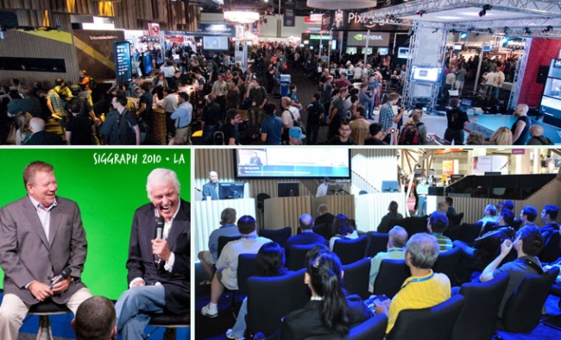
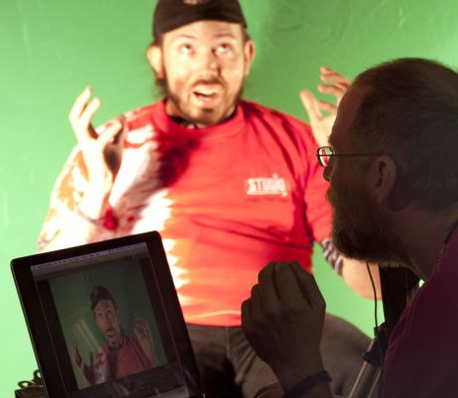
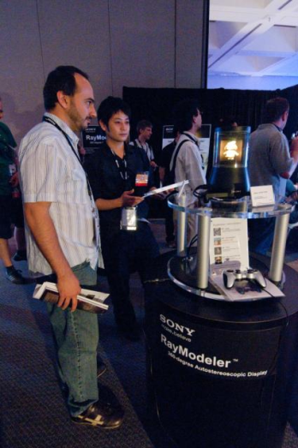
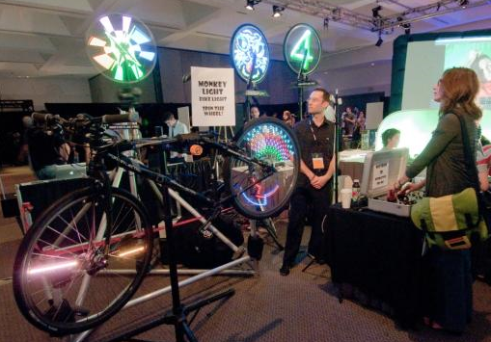
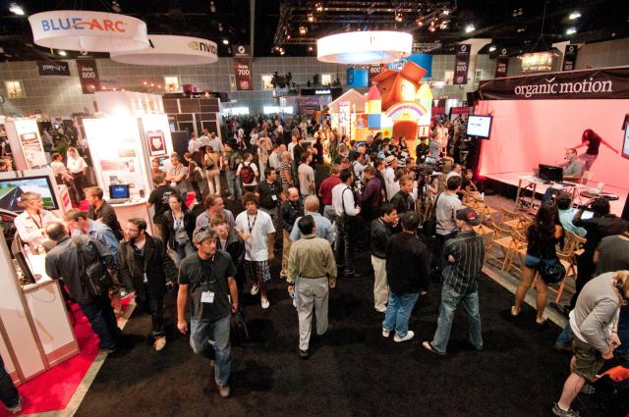

Slide 5
What‘s the
student volunteer program?
A unique opportunity to volunteer behind-the-scenes
Did you know that SIGGRAPH is run entirely by volunteers? It’s true!
Why participate?
  Student Volunteers are an integral part of the conference –
  the atmosphere, community, the list goes on and on…
  Great networking opportunity!
  Awesome perks!

Slide 6
Volunteer Perks:
⋅ Receive a full-conference pass to SIGGRAPH
(access to all the classes, panels, exhibits, etc.)
⋅ Meet and work directly with industry professionals
⋅ Attend special sessions exclusively for student volunteers
⋅ Meet other students with similar interest in computer graphics
⋅ 1 Year student membership to ACM SIGGRAPH
⋅ Get to wear a snazzy red vest – awesome, right?
That’s a lot of perks right there!

Slide 7
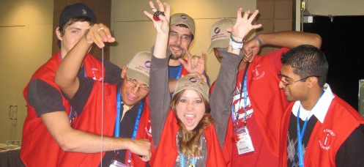
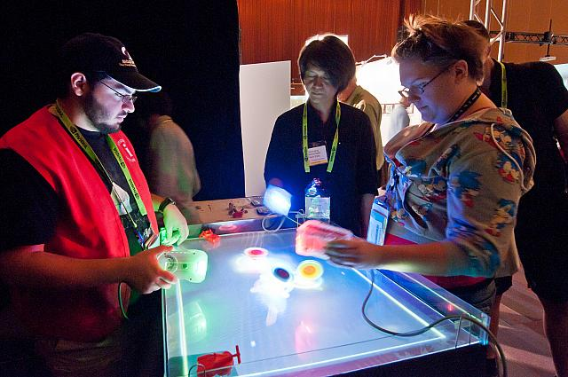
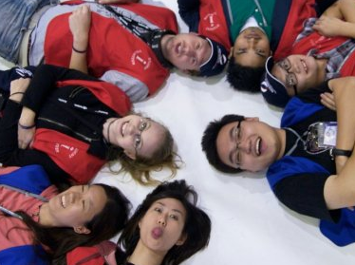
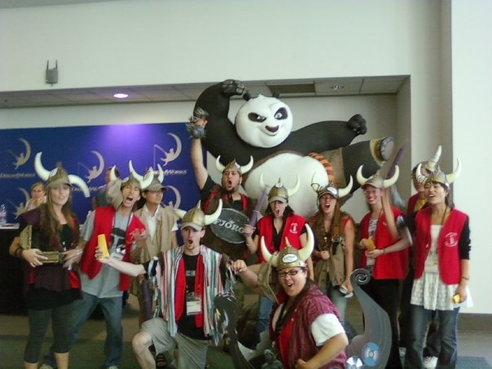
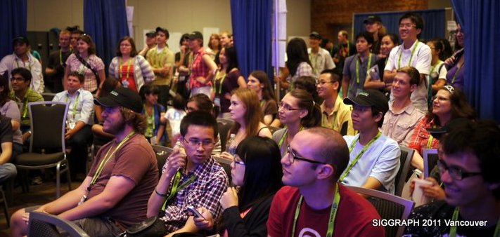

Slide 8
Volunteer Requirements:
Enrolled as a full-time high school, undergraduate, or graduate student during some part of the 2011-2012 academic year
At least 18 years of age by Saturday, 4 August 2012
Available from Saturday, 4 August to Thursday, 9 August 2012
Commit to working 18 or 30 hours during the conference
Provide a current, government-issued photo ID
No prior experience with the annual conference or computer graphics is necessary or required

Slide 9
Deadline to apply:
Monday, 13 February 2012
22:00 UTC/GMT
Apply online at:
sis.siggraph.org
More information can be found at:
sv.siggraph.org

Slide 10
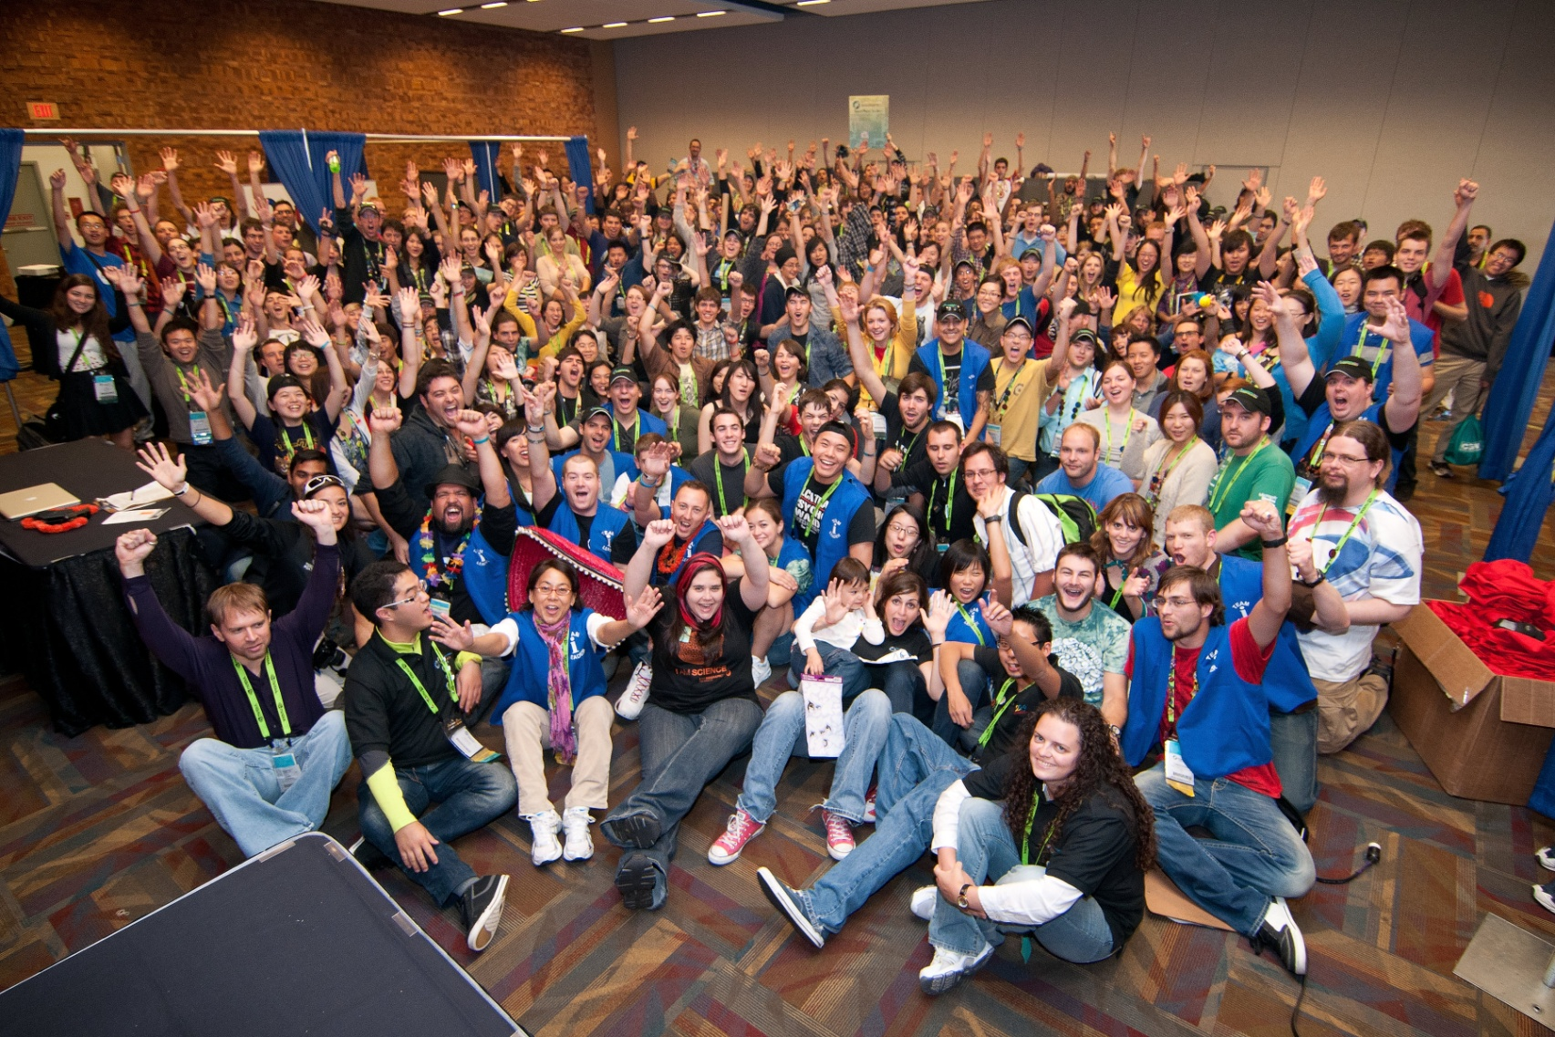

Slide 11
See you in
Los Angeles!

